Slide 1
Exploring Artificial Intelligence
Fashion MNIST
NN
Neural Network Classification
AI Modeling with Fashion MNIST Dataset (Zalando)
Group Member:
Jo-ann Obewe
Omole Peter
Naimot Yekini
Khaled Ahmed
Neural Network

Slide 2
01 Project Introduction
Objective
Develop a Neural Network classifier to recognise images from the Fashion MNIST dataset across 10 clothing categories.
Pipeline
Data
Preprocessing
Data
Splitting
Model
Training
Hyperparameter
Tuning
Model
Evaluation
The Challenge
The Approach
Why It Matters
Classify tiny 28×28 pixel grayscale images of clothing items into one of 10 categories — automatically, without human labelling.
A Fully Connected Neural Network trained end-to-end using TensorFlow/Keras with manual hyperparameter tuning.
Enables product tagging, visual search & inventory automation in e-commerce — processing thousands of images in milliseconds.

Slide 3
02 Dataset Introduction
10 Clothing Categories
70,000
60,000
T-shirt / Top
Trouser
Total Images
Training Images
Pullover
Dress
10,000
28 × 28
Coat
Sandal
Test Images
Pixel Size (grayscale)
Shirt
Sneaker
10
6,000
Bag
Ankle Boot
Clothing Classes
Images Per Class

Slide 4
03 Data Preprocessing & Splitting
1
Normalisation
Pixel values scaled from 0–255 → 0–1
Converting to float32 before dividing by 255. Ensures stable, faster gradient descent during training.
X = X.astype('float32') / 255.0
2
Reshaping
Images flattened: 28×28 → 784 pixels
Each 2D image grid is unrolled into a 1D vector of 784 values for Dense (fully connected) layers.
X = X.reshape(-1, 28 * 28)
3
Data Splitting
60,000 training images split into:
• Train: 49,500 (70.7%)
• Validation: 10,500 (15%)
• Test: 10,000 (14.3%)
stratify=y → balanced classes

Slide 5
04 Model Architecture & Training
Network Architecture
Training Configuration
Input Layer
Optimiser
Adam (learning rate = 0.001)
784 neurons (28×28 pixels)
Loss Function
Sparse Categorical Cross-Entropy
Dense Layer 1
Batch Size
64 images per step
128 neurons | ReLU | Dropout 30%
Max Epochs
30 (with early stopping)
Early Stopping
Patience = 5 (monitors val_loss)
Dense Layer 2
64 neurons | ReLU | Dropout 30%
Regularisation
Dropout = 0.30 per hidden layer
Configs Tested
5 different architectures
Output Layer
10 neurons | Softmax
Best Val Acc.
89.85% (Config 2 — 2 layers, 128n)
Test Accuracy
Test Accuracy
88.54% | Test Loss: 0.3334
88.54% | Test Loss: 0.3334

Slide 6
05 Implementation Highlights
① Model Builder Function
③ 5 Key Design Decisions
def build_model(hidden_layers=2, neurons=128,
activation=
'relu', dropout_rate=0.3): model = keras.Sequential() model.add(Dense(neurons, activation=activation)) model.add(Dropout(dropout_rate)) model.add(Dense(10, activation='softmax'))
1
Reusable builder
One function handles all 5 configs — hidden layers, neurons, activation, dropout & lr are all parameters, not hardcoded.
2
Neuron halving per layer
Each extra hidden layer gets neurons // 2 — compresses features gradually, like a funnel, forcing the network to abstract.
3
Softmax output
② Training Call + Early Stopping
10-neuron output with Softmax converts raw scores into probabilities that sum to 1 — ideal for multi-class classification.
early_stop = EarlyStopping( monitor='val_loss', patience=5,
restore_best_weights=
True) model.fit( X_train, y_train, epochs=30, batch_size=64,
validation_data=
(X_val, y_val),
callbacks=
[early_stop])
4
Stratified split
stratify=y ensures all 10 classes appear proportionally in train, val, and test — no class imbalance introduced by splitting.
5
Restore best weights
Early stopping with restore_best_weights=True rolls back to the epoch with lowest val_loss, avoiding accidental underfitting.
Group 6 · Fashion MNIST Neural Network Classification

Slide 7
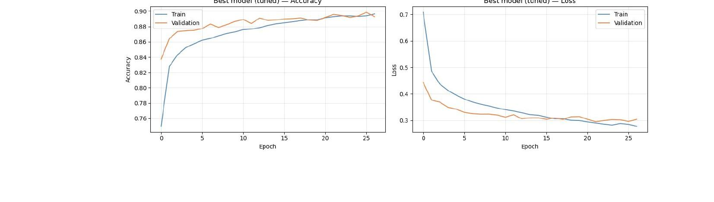
05 Training Results — Learning Curves
Baseline Model — Accuracy & Loss Curves (25 Epochs, Early Stopped)
Fast Convergence
No Overfitting
Best Val Accuracy
Model improves rapidly in first 5 epochs, stabilising around epoch 15–20
Train and validation curves remain close — good generalisation
89.19% achieved at epoch ~20, then plateau triggers early stop at epoch 25

Slide 8
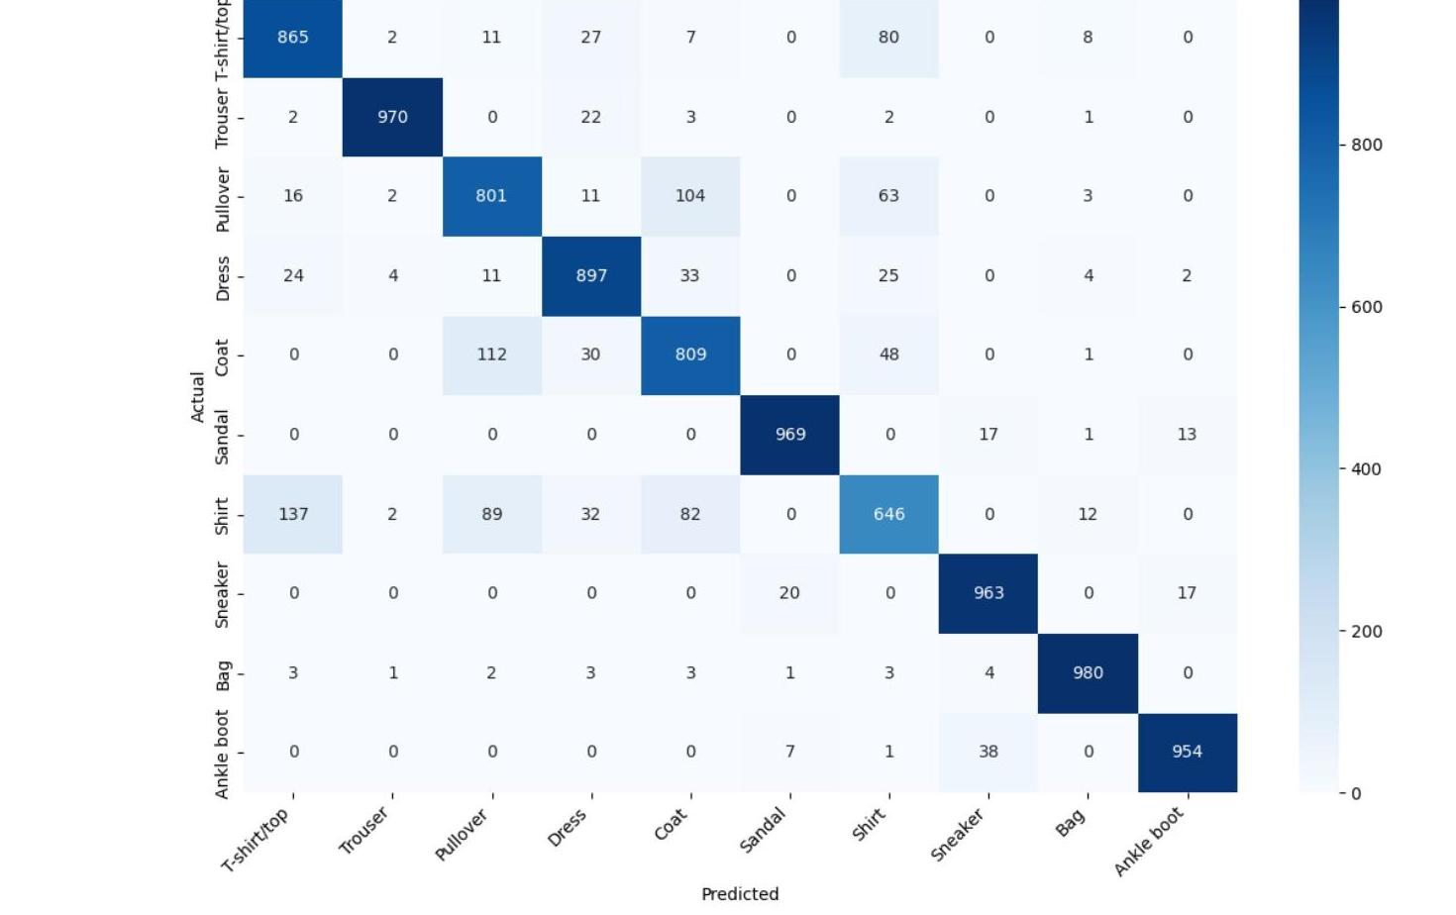
06 Evaluation — Confusion Matrix
Confusion Matrix — 10,000 Test Images
Top Misclassifications
Shirt → T-shirt
137
Coat → Pullover
112
Pullover → Coat
104
Shirt → Pullover
89
Shirt → Coat
82
T-shirt → Shirt
80
Pullover → Shirt
63
Upper-body tops remain hardest to distinguish

Slide 9
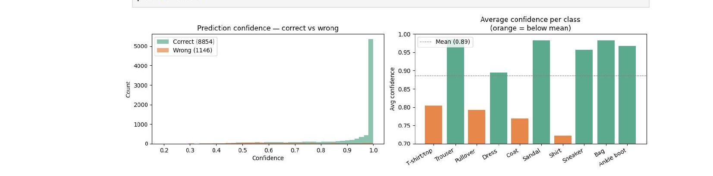
07 Confidence Analysis & Conclusion
Prediction Confidence Distribution
Final Results
Test Accuracy:
88.54%
Macro F1 Score:
0.88
Best Class (F1):
Trouser / Bag — 0.98
Hardest Class:
Shirt — 0.69
Total Errors:
1,146 / 10,000
Conclusion & Future Work
A Dense Neural Network with 2 hidden layers (128→64 neurons) reached 88.54% test accuracy on 10,000 unseen images.
Structurally distinct items (Trouser, Bag, Sandal) achieved near-perfect F1 of 0.97–0.98; visually similar tops remain challenging.
Future improvements: Convolutional layers (CNN), Batch Normalisation, Data Augmentation, and Learning Rate Scheduling.
Group 6 · Fashion MNIST Neural Network Classification

